Slide 1
Camera Model
Chul Min Yeum
Assistant Professor
Civil and Environmental Engineering
University of Waterloo, Canada
CIVE 497 – CIVE 700: Smart Structure Technology
Last updated: 2019-03-07

Slide 2
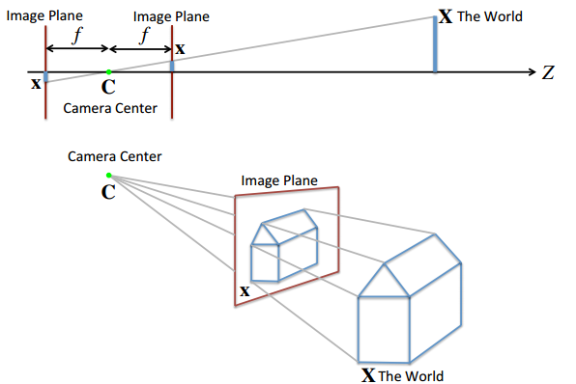
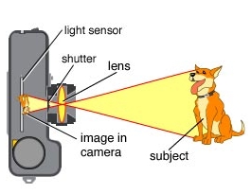
(Review) Pinhole Camera Model

Slide 3
How to Model Projection
How to mathematically model the projection of 3D scenes on images

Slide 4
(Review) Both Lens and Pinhole Camera
We can derive properties and descriptions that hold for both camera models if:
We use only central rays.
We assume the lens camera is in focus.
We assume that the focus distance of the lens camera is equal to the focal length of the pinhole camera.

Slide 5
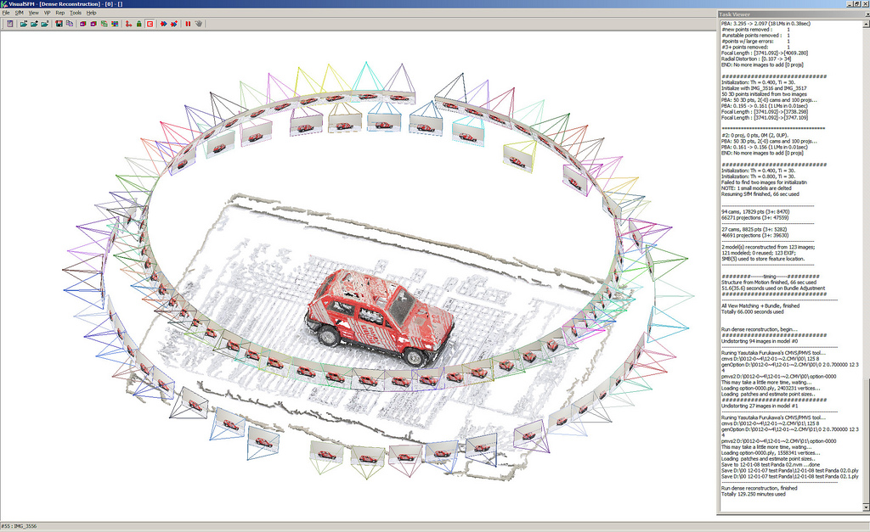
Camera Representation

Slide 6
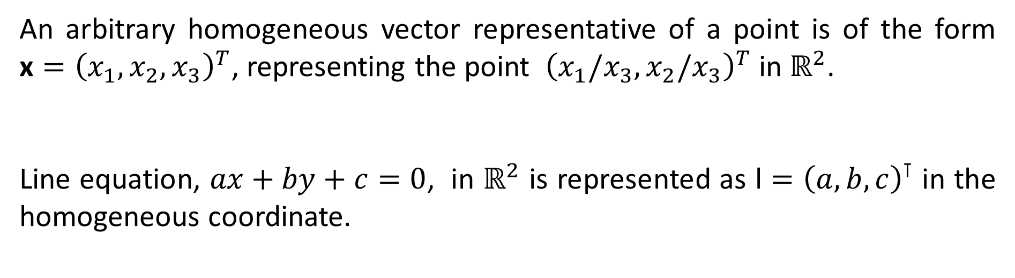
(Review) Homogeneous Coordinate
An arbitrary homogeneous vector representative of a point is of the form $\text{x}={\left(x_{1},x_{2},x_{3}\right)}^{T}$, representing the point ${\left(x_{1}/x_{3},x_{2}/x_{3}\right)}^{T} \text{in} ℝ^{2}$.
Line equation, $ax+by+c=0$, in $ℝ^{2}$ is represented as $\text{l}={\left(a,b,c\right)}^{⊺}$ in the homogeneous coordinate.

Slide 7
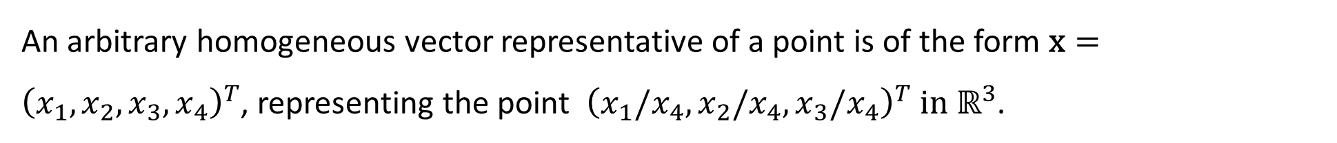
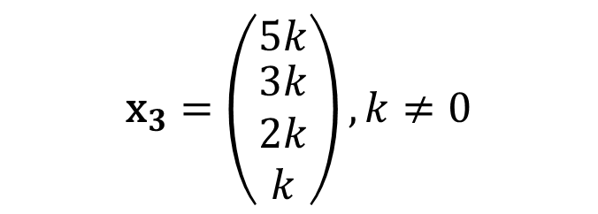
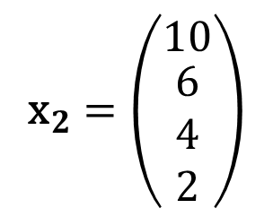
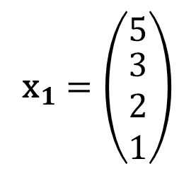
Representing Points in 3D
An arbitrary homogeneous vector representative of a point is of the form $\text{x}={\left(x_{1},x_{2},x_{3}, x_{4}\right)}^{T}$, representing the point ${\left(x_{1}/x_{4},x_{2}/x_{4},x_{3}/x_{4}\right)}^{T} \text{in} ℝ^{3}$.
$${\text{x}}_{1}=\left(\begin{matrix}5 \\ \begin{matrix}3 \\ 2 \\ 1\end{matrix}\end{matrix}\right)$$
$${\text{x}}_{2}=\left(\begin{matrix}10 \\ \begin{matrix}6 \\ 4 \\ 2\end{matrix}\end{matrix}\right)$$
$${\text{x}}_{3}=\left(\begin{matrix}5k \\ \begin{matrix}3k \\ 2k \\ k\end{matrix}\end{matrix}\right),k≠0$$
Example)
up to a scale
${\text{x}}_{1},$ ${\text{x}}_{2}$, ${\text{x}}_{3}$ and ${\text{x}}_{4}$ indicate the same point of (5, 3, 2) in $ℝ^{2}$

Slide 8
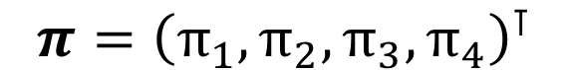
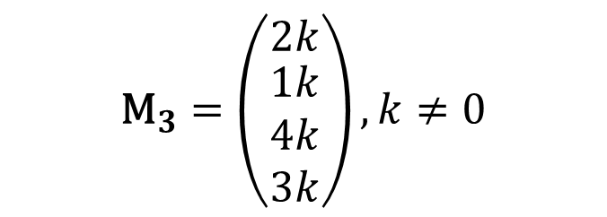
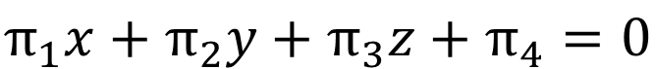
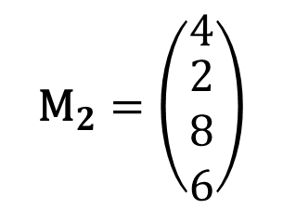
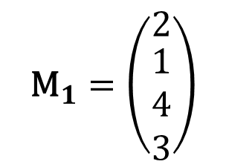

Representing Plane in 3D
$$π_{1}x+π_{2}y+π_{3}z+π_{4}=0$$
$$π={\left(π_{1},π_{2},π_{3},π_{4}\right)}^{⊺}$$
Plane equation in $ℝ^{3}$
Plane representation in HC
$${\text{M}}_{1}=\left(\begin{matrix}2 \\ \begin{matrix}1 \\ 4 \\ 3\end{matrix}\end{matrix}\right)$$
$${\text{M}}_{2}=\left(\begin{matrix}4 \\ \begin{matrix}2 \\ 8 \\ 6\end{matrix}\end{matrix}\right)$$
$${\text{M}}_{3}=\left(\begin{matrix}2k \\ \begin{matrix}1k \\ 4k \\ 3k\end{matrix}\end{matrix}\right),k≠0$$
Example)
${\text{M}}_{1},{\text{M}}_{2}$, and ${\text{M}}_{3}$indicate the same plane of $2x+y+4z+ 3=0$ in $ℝ^{3}$

Slide 9

Image Geometry (World Coordinate)
W
Object of interest in World Coordinate System (U, V, W)
U
V
example of world coordinate?

Slide 10
Image Geometry (Camera Coordinate)
Camera Coordinate System (X, Y, Z)
Film Coordinate system (x, y)

Slide 11


Image Geometry (Pixel Coordinate)
Camera coordinates
W
World coordinates
Pixel coordinates
U
V
u
v
Pixel coordinates: Our image gets digitized into pixel coordinates (u,v)

Slide 12
Forward Projection
World Coordinates
Camera
Coordinates
Film
Coordinates
Pixel
Coordinates
U
V
W
X
Y
Z
x
y
u
v
We want a mathematical model to describe how 3D World points get projected into 2D pixel coordinates

Slide 13
Backward Projection
World Coordinates
Camera
Coordinates
Film
Coordinates
Pixel
Coordinates
U
V
W
X
Y
Z
x
y
u
v
Much of vision concerns trying to
derive backward projection equations to
recover 3D scene structure from images.
Scene from images

Slide 14
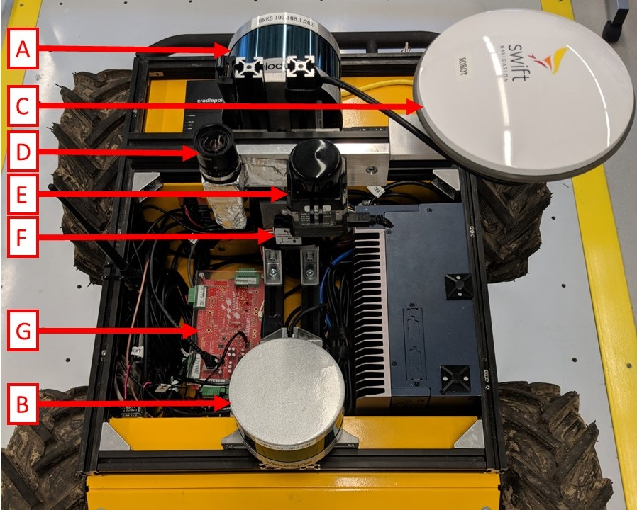
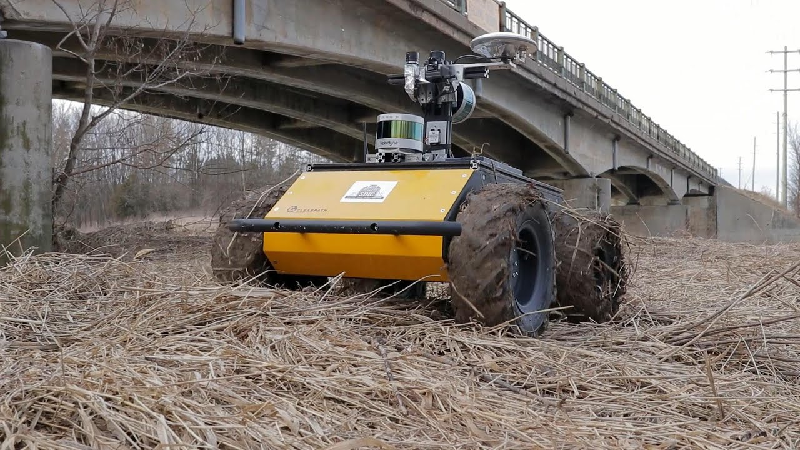
Example: Coordinate Transformation
https://www.youtube.com/watch?v=YCihWIBIGZ8

Slide 15
Projection Matrix (Camera Matrix)
If we knew a projective matrix in an image, we can compute the image point corresponding to the world point
Although we knew an image points, we cannot find an unique world point.
2D point
3D point

Slide 16

Example: Unknown Scale

Slide 17
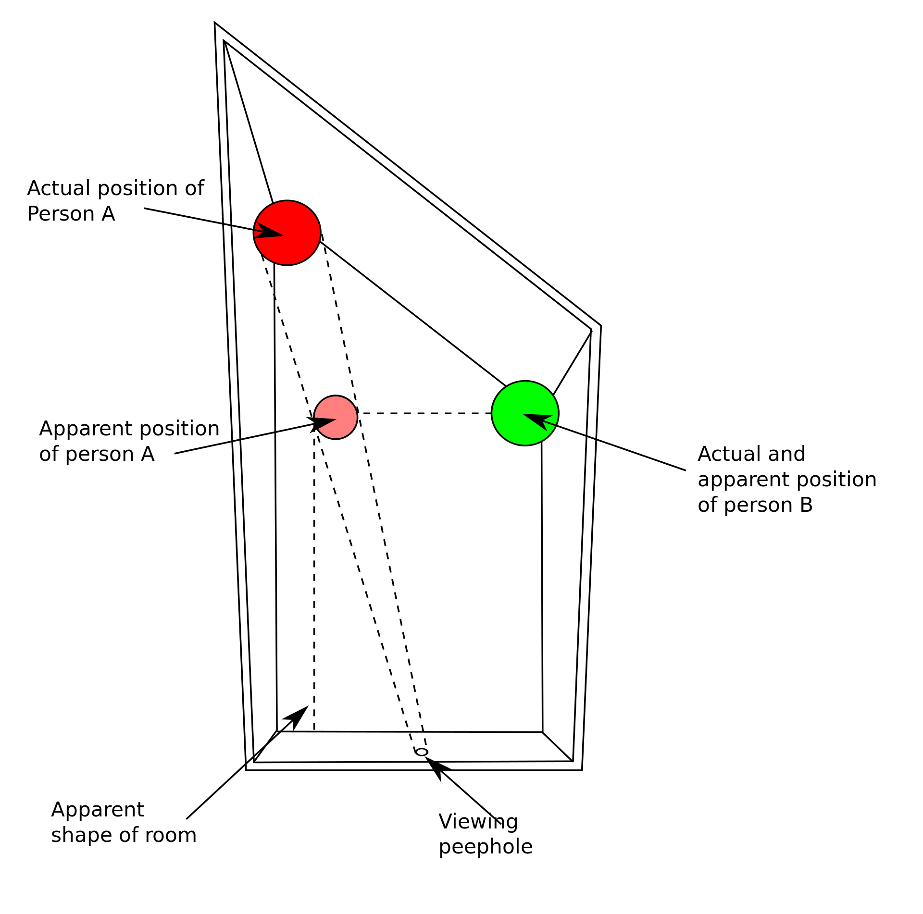
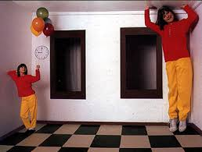
Example: Ames room

Slide 18
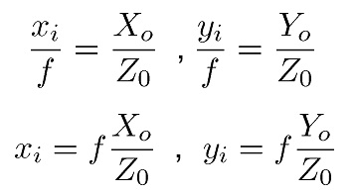
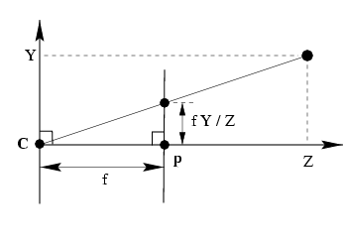
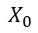
Camera Model: A Simple Case
$$X_{0}$$
Up to scale !!!
Any point on the ray OP is projected onto a same image point.
Only valid at homogeneous coordinate
1 Unknown

Slide 19
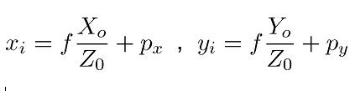
Camera Model: Pixel Coordinate w.r.t. the Image Origin
If the image center (principal point) is not the center of the image,
3 Unknowns

Slide 20
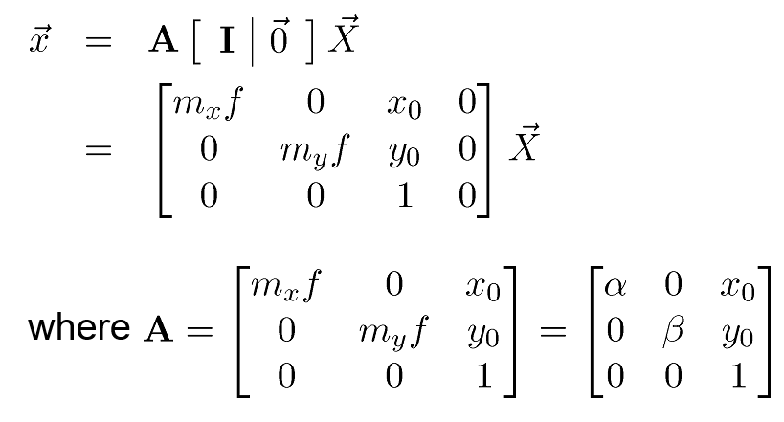
(Optional) Camera Model : When Different Pixel/Unit Ratios in X and Y Directions
4 Unknowns

Slide 21
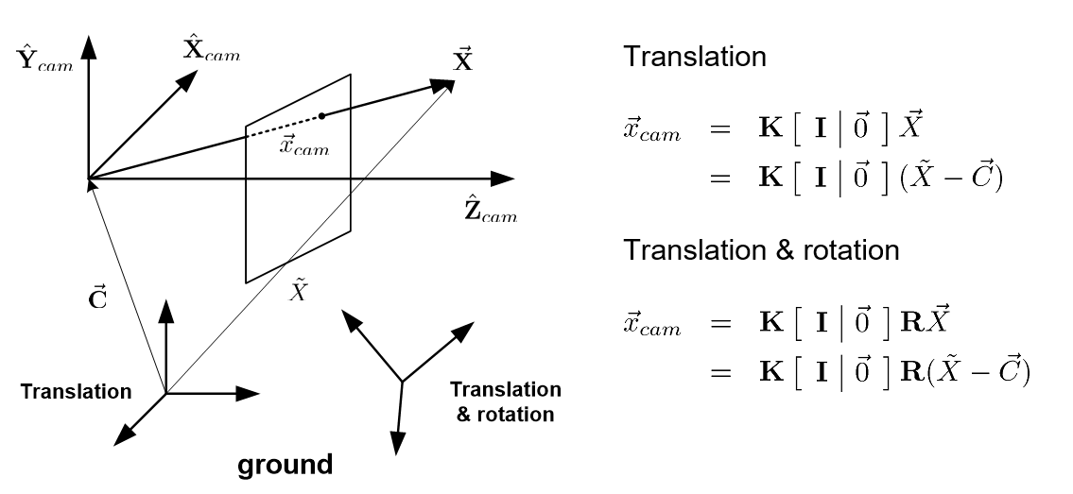
Camera Model : Full Configuration
Multiview geometry
Rotation matrix (3)
Camera center (3)
Focal length (1~2)
Principal points (2)
9 (10) Unknowns

Slide 22
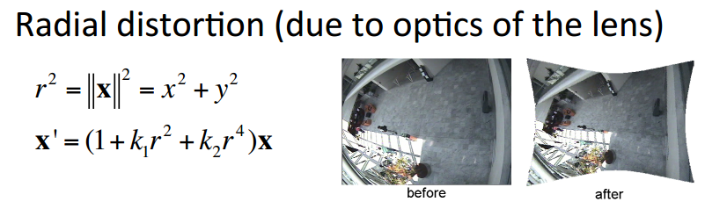
Radial Distortion
Image plane
World point
distortion
9 (10) + # of distortion parameters unknowns

Slide 23
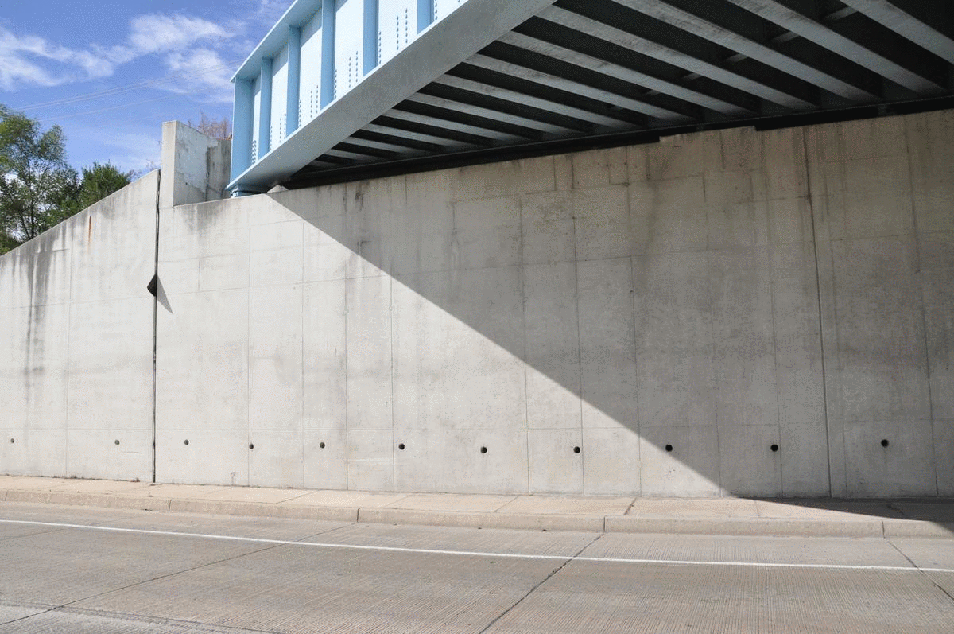
Example: Lens Distortion Correction

Slide 24
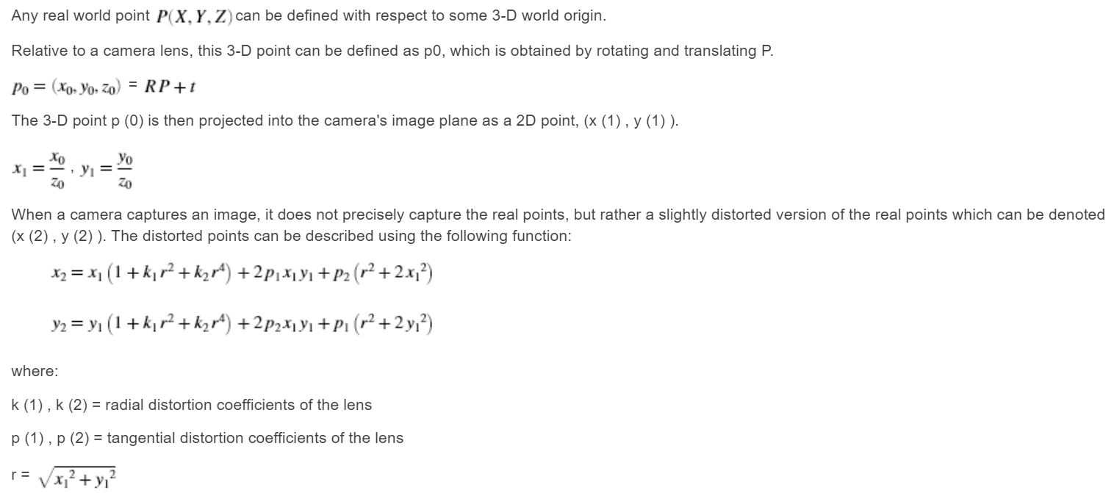
Example: Camera Distortion Model in MATLAB
https://www.mathworks.com/help/symbolic/examples/developing-an-algorithm-for-undistorting-an-image.html

Slide 25
Camera Matrix
With respect to the world coordinate

Slide 26
Review All Terms
Rotation matrix (3)
Translation matrix (3)
Focal length (2)
Principal points (2)
Lens distortion parameters (2~4)
Exterior (External)
Interior (Internal)

Slide 27
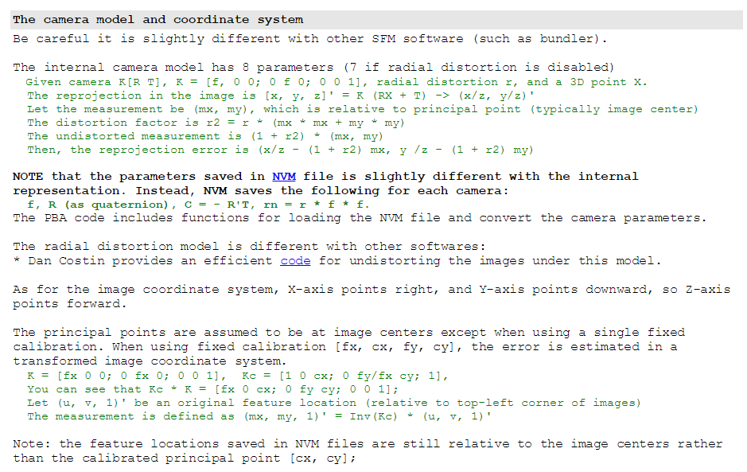
Example: VisualSfM (http://ccwu.me/vsfm/doc.html)

Slide 28
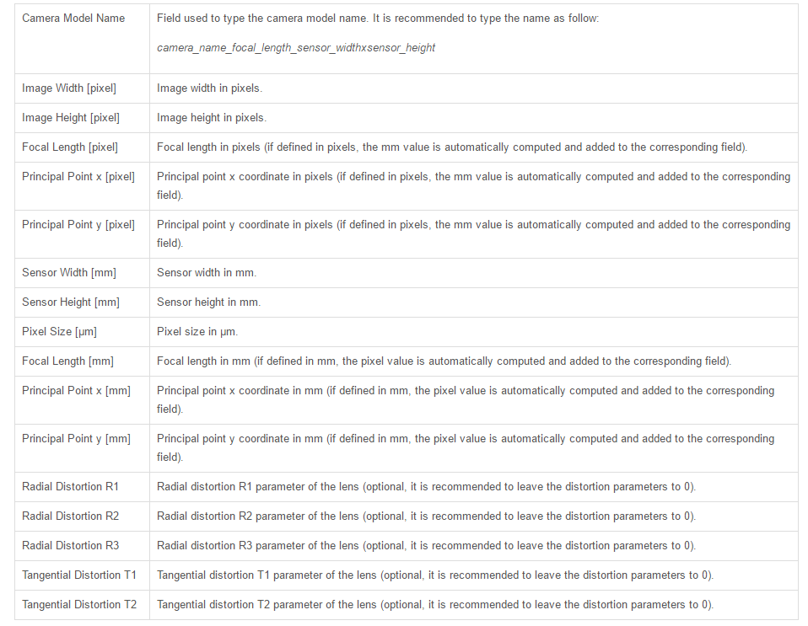
Example: Pix4D
https://support.pix4d.com/hc/en-us/articles/202560169#gsc.tab=0

Slide 29
Projective Matrices of Multiple Images
i : Image number
2D point
3D point
If we knew a projective matrix in each image, we can compute the image point corresponding to the world point
If we knew more two image points indicating same world point, we can compute the location of the world point. (triangulation)

Slide 30
Slide Credits and References
Lecture notes: Robert Collins
Hartley, Richard, and Andrew Zisserman. Multiple view geometry in computer vision. Cambridge university press, 2003.

